Slide 1

Space Biology Knowledge Engine
Harnessing NASA's bioscience experiments for deep-space exploration
Presented by : Mannu Mourya
Yogesh Kumar Navdeep Kaur

Slide 2
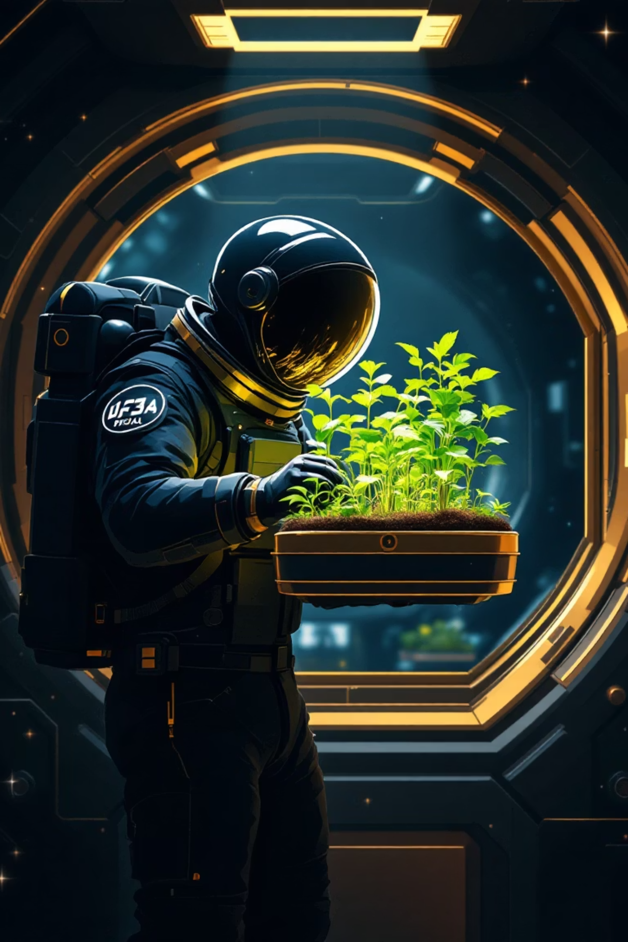
Why We Need a Unified Bioscience Resource
Decades of NASA space biology experiments hold vital insights for Moon and Mars missions, yet data remains scattered across thousands of publications. This fragmentation slows research on life support systems and microgravity adaptations. The Space Biology Knowledge Engine addresses this by creating a centralized, searchable repository, accelerating discovery for mission planners and scientists.

Slide 3

Compiling NASA's Space Biology Data
Our dataset draws from public NASA sources, including key experiments on plant growth and adaptation in space. This compilation spans over 50 years, covering diverse organisms and environments.
Experiment
Years
Organisms
Key Findings
PESTO
2017
Wheat
Grew ~10% taller in microgravity1
Seedling Growth
2010-2015
Arabidopsis
Altered gene expression patterns2
XROOTS
2019-2022
Various plants
Hydroponic/aeroponic systems viable3
ADVASC, Veg-03, Veg-05, PH-03, PH-04
2000-2023
Lettuce, radish
Nutrient uptake changes in space
1: tallernasa.gov | 2: changesnasa.gov | 3: systemsscience.nasa.gov

Slide 4

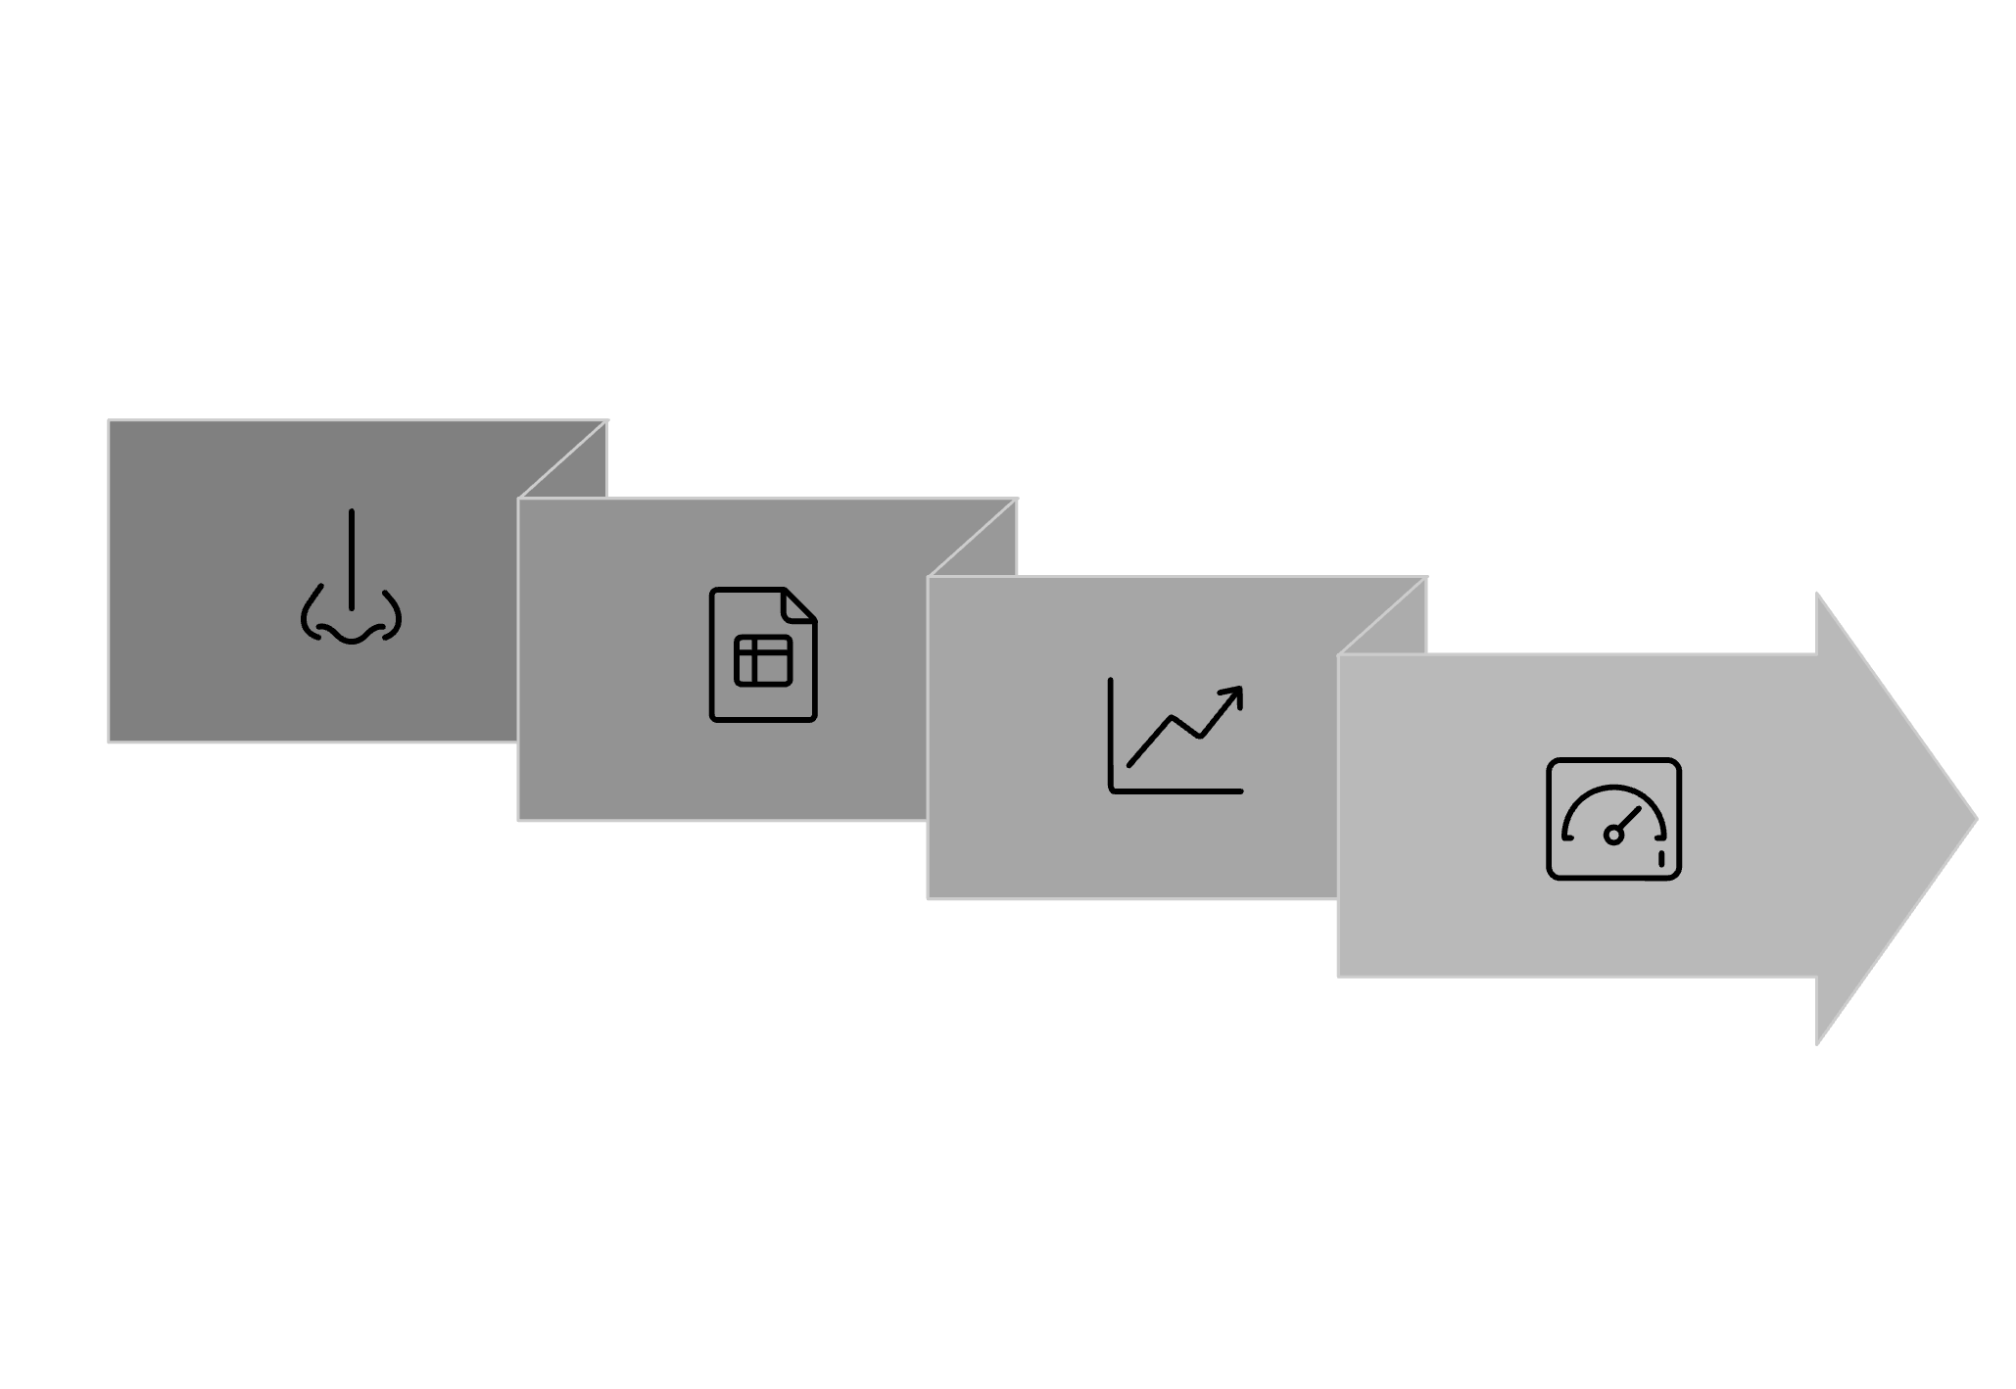


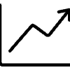

The Space Biology Knowledge Engine: Core Solution
This engine transforms scattered NASA data into an actionable resource. It ingests structured metadata from experiments, constructs a knowledge graph connecting biological entities and outcomes, and delivers an interactive FastAPI-based dashboard for exploration. Researchers can query links between microgravity effects and organism responses, streamlining mission design.
CSV Ingestion
Interactive Dashboard
NASA Publications
Knowledge Graph

Slide 5

Building the Knowledge Graph
The graph structures relationships across experiments, organisms, and biological concepts. Nodes represent entities—experiments (blue), organisms (orange), and concepts like gene expression (green)—linked by edges showing influences, such as how microgravity alters plant signaling. Users filter by experiment type for targeted insights, revealing patterns in space adaptation.

Slide 6




Interactive Dashboard Features
Experiment Index
Detailed Pages
Plotly Visualizations
Browse a comprehensive list of experiments with quick summaries and filters by organism or year.
Access in-depth views with experiment overviews, key findings, and full citations for deeper analysis.
Interactive graphs display trends, such as growth rates across missions, enabling dynamic data exploration.

Slide 7

Technical Stack and Implementation
Built on Python 3.11, the engine uses FastAPI for the robust web server, a custom knowledge-graph builder without external libraries, Pandas for efficient data loading, Plotly for dynamic visualizations, and Jinja2 for templated HTML interfaces. This stack ensures scalability and ease of integration with NASA systems.
Example graph construction snippet:
# Connect experiment to organism nodedef link_experiment_to_organism(exp_id, org_name): graph.add_edge(exp_id, org_name, relation='tested_on') return graph

